Slide 1


Goal Setting in Mental Health

Slide 2

Presented by Carroll Chapman

Slide 3
Do Goal-Setting Interventions
Improve the Quality of Goals in
Mental Health Services?
Psychiatric Rehabilitation Journal
2009, Volume 32, No. 4, 292–299
Samantha P. Clarke, Trevor P. Crowe,
Lindsay G. Oades and Frank P. Deane

Slide 4

Lesson 12:
Developing Service Goals

Slide 5

Purpose?

Slide 6
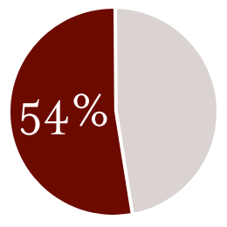
In this Study 54% of those who were successful with their recovery used goal setting principles.

Slide 7
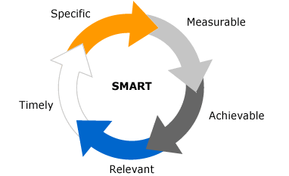
S.M.A.R.T.
Notes:
Goal Theory
identifies specific factors found to promote
goal attainment by enhancing
motivation and directing attention.
These factors include 1) identifying
goals that are clearly defined, measurable
and difficult, 2) setting goals that
promote self-efficacy and are important
to the individual, 3) developing
strategies or plans to attain goals, 4)
setting a time frame for goals to be reviewed,
5) monitoring goal progress
and provision for regular feedback
about performance, and 6) problem
solving potential barriers likely to impede
goal progress. These Goal Theory
principles formed the basis for the
SMART (specific, measurable, agreed
to, realistic, timely) goals acronym,
often applied to improve goal-setting
quality in various contexts, including
vocational, educational, coaching and
health. Within mental health settings
collaborative goals

Slide 8

Hope & Meaning
Notes:
Goal
setting has also been linked with the
promotion of hope and personal meaning,
two important processes associated
with psychological recovery

Slide 9

Aiming for the best results for our clients.

Slide 10

Goal setting is important. Training on proper goal design is critical in the success of those trying to achieve goals.

Slide 11

Smart People like this!

Slide 12

That training is being given which means we’re right on target!

