Slide 1

Psychology and bdsm
Amber Chisholm
Case Management Spring 2015
Mark Kavanaugh
Article Presentation

Slide 2
Have you ever felt relief from just being able to take orders?
Or have you felt good about being in power and being able to give the orders?

Slide 3
Attitudes and Assumptions
Society- not accepting of things outside the “norm”
Example: Lesbian and gay marriage
Recent media flare of BDSM
Maybe we don’t agree, or maybe we just don’t understand?

Slide 4
Article Information
“An Examination of Personality Characteristics Associated with BDSM Orientation”
Written By: Ali Herbert and Angela Weaver
Published in the Canadian Journal of Human Sexuality
2014
Related to Lesson 17: Assumptions, Attitudes and Boundaries

Slide 5

A Simple Definition
BDSM:
Bondage-discipline: physical or psychological restraints
Domination-submission: exchange of power or control
Sadomasochism: taking pleasure in own or other’s pain
Play: scenes and activities carried out in the BDSM community
For this article focus is on dominants and submissives.

Slide 6
“Safe, Sane, and Consensual”
Psychology of what happens is widely known.
Negotiations are made before hand.
Dominant is responsible for the well being of the submissive.
Mental health is extremely important.
This article looks to expand research on personality characteristics that relate to the psychology of BDSM.

Slide 7
Methods
Invitation sent out through Reddit.com
At least 18 years of age, average age was 25
Must identify as strictly dominant or submissive
270 participants
80 dominant, 190 submissive
93 males, 168 females, 7 transgender, and 2 who did not identify their gender

Slide 8

Methods
Many tests used together:
Shapiro control inventory
The interpersonal reactivity index
HEXACO-60
Self report altruism scale
Rosenberg self esteem scale
Satisfaction with life scale.

Slide 9
Results
Results compared to General Public
Tested within normal limits for mental health issues
Narcissism was more prevalent
No significant difference in self-esteem, life satisfaction, or empathy.
Lower scores in altruism
Submissives scored higher in openness to experiences

Slide 10
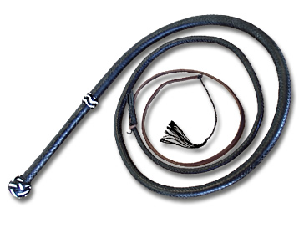
Results
Results comparing dominants and submissives
Dominants scored higher in desire for control, extraversion, self esteem, and life satisfaction.
Submissives scored higher in emotionality
No significant difference in empathy, honest-humility, conscientiousness, altruism, agreeableness.
60% agreed equal power during play
20% submissives have true control

Slide 11
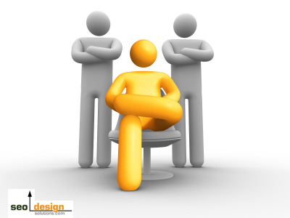
Conclusion
They are just people…as each of us are just people.
The sooner we learn tolerance, the better off we will be.
Especially in a career field where each day can be unpredictable.

Slide 12
Resource
Herbert, A., & Weaver, A. (2014). An Examination of Personality Characteristics Associated with BDSM Orientations. Canadian Journal of Human Sexuality, 2(23), 106-115.

