Slide 1


Does Case Management Improve Linkage to Substance Abuse Treatment?
By Erin Falconer
https://s3.amazonaws.com/mediaManagerLocal/nursing%20case%20management.jpg.jpg

Slide 2
Improving Linkage with Substance Abuse Treatment using Brief Case Management and Motivational interviewing
By Richard Rapp, Amy Otto, Timothy Lane, Cristina Redko, Sue McGatha and Robert Carlson
Published in 2008
Volume 94 (1-3), pages 172-182
National Institute of Health

Slide 3

Lesson 7: Initial Interview
Gathering information
Figuring out the client’s strengths, weaknesses and barriers
Developing a plan for services.
http://www.summithelps.com/wp-content/uploads/2013/07/Individual-Therapy-and-Addiction-Treatment.jpg

Slide 4

Purpose
Linkage to substance abuse treatment remains a problem!
Barriers to Treatment
Transportation
Childcare
Homelessness
Waiting lists
Lack of services
Motivation
Perceived extent of substance abuse problem
http://raisingthewholechild.com/images/Barriers-Personal-Growth-Development.jpg

Slide 5
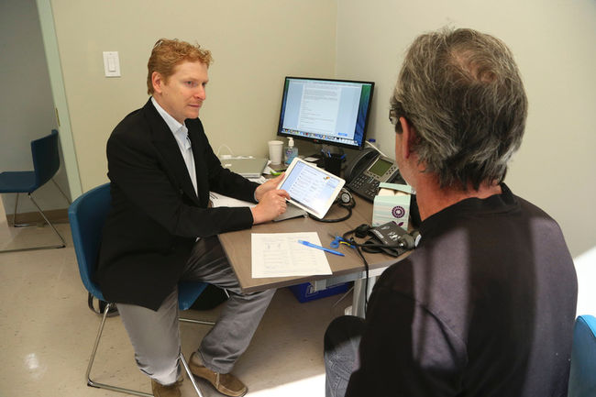
Methods
Assessment
Referral
Early intervention
Outpatient
Intensive outpatient/partial hospitalization
Residential/inpatient
Medically managed intensive inpatient treatment
http://storage.torontosun.com/v1/dynamic_resize/sws_path/suns-prod-images/1297585592767_ORIGINAL.jpg?quality=80&size=650x

Slide 6

Control Group: (Standard of Care)
1/3 of the clients were instructed to call intake unit in 1 week to schedule start day for treatment
No face to face contact
No barriers were discussed
http://i.ytimg.com/vi/vhDD5qZOFHA/hqdefault.jpg

Slide 7

Motivational Interviewing (MI)
1/3 of clients had 1 hour session with a trained MI counselor
Sessions were designed to:
talk about motivation for treatment and the client’s current life and goals for the future.
https://educateria.files.wordpress.com/2014/12/motivational-interviewing-oars.png

Slide 8

Strengths Based Case Management (SBCM)
1/3 of clients met with case managers for 5 sessions, which included
Talk about strengths and abilities
Client decision-making in plans to link with treatment
Building the relationship
Client participation in plan development
Contact clients in their own environment
http://www.personalitytutor.com/files/2012/02/Goal-Setting-Tips.jpg

Slide 9
Results
Client Info
Most Serious Drug Problem
Referrals
Men: 429
Women: 249
Average age: 33.4
Employed: 58 %
Homeless: 20.2 %
Criminal: 50 %
Treatment experience: 70%
Crack or powder cocaine: 45.6%
Heroin: 22 %
Marijuana: 14.9 %
Alcohol: 11.6 %
Other drugs: 5.9 %
Outpatient treatment: 49 %
Residential programs: 31 %
Outpatient methadone maintenance program: 18%

Slide 10
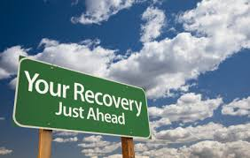
Results (cont.)
Clients in the Strengths Based Case Management were 2X more likely to achieve linkage! +
Women +
Education +
Prior treatment experience +
Motivational Interviewing -
Homelessness -
http://www.blueskytreatment.com/addiction-substance-abuse-treatment/

Slide 11

Conclusion
Case Management is extremely beneficial to a person who is recovering from drug addiction.
Treatment linkage is only the 1st step!
People in recovery need to learn how to live without the use of drugs.
Goal setting and implementation is very important!
http://www.arbourhealth.com/img/substance_abuse_image_right.jpg

