Slide 1

case management helping to prevent veterans from homelessness !
By Karin McKenzie
April,1 2015

Slide 2
Introduction
Many individuals, especially veterans who have mental illness struggle to survive every day and usually become homeless. Veterans with mental illness are at a high risk for being homeless, because going from an everyday routine to living in a small town can be a challenge to someone who has a hard time adjusting, but then having to adjust back to a home routine can be a challenge and in some ways traumatizing. Many people do not realize there is a gap from transition from war to home and many people do not know the resources that are available to them which are where case management comes in. Case managers know the severance of transitioning from one life style to the other and know how hard it is for individuals to adjust and need help adjusting and finding the right resources so they do not end up on the street or falling into a depression.

Slide 3
Information about the article
Article
  Outcomes of Critical Time Intervention Case Management of Homeless Veterans After Psychiatric Hospitalization
Authors
  Wesley J. Kasprow , Ph.D., M.P.H.; Robert A. Rosenheck , M.D.
Journal Name
  PSYCHIATRIC SERVICES
Date published
  July 2007 Vol. 58 No. 7

Slide 4
Brief statement about which Lesson in the course the article applies to and why
This article relates to Lesson 7 the interview, because you need to see what services the individual needs.
Examples
  VA
  Food stamps
  Medical
  Housing assistance

Slide 5
Essential elements of the article
“From 2001 to 2004, the Department of Veterans Affairs (VA) implemented a modified version of CTI at eight VA medical centers (VAMCs) for homeless veterans with serious mental illness who were current inpatients. Homeless inpatients are at high risk of continued homelessness as well as hospitalization and were thus identified as a priority group for this intervention” (Kasprow, W., & Rosenheck, R. (2007, July 1)). In my opinion this message is extremely clear that this has been going on for many years and that people want to help and find the right resources for these veterans with mental health illnesses and provide the proper services for these individuals. Whether people realize it or not Many men and women suffer from mental illness and need proper help, they do not need to be homeless, scared, hungry, and asking strangers for help. These individuals need case managers and the resources they can give them.

Slide 6
The purpose of the article
The purpose of this article is to educate people about veterns with mental illness, being homeless and how case managers can help.

Slide 7
Description of the methods used by the authors
Eight VAMC.
  According to psychiatryonline.org “The eight sites were located in Chicago and Hines, Illinois; Houston; Lyons, New Jersey; Montrose, New York; Richmond and Salem, Virginia; and San Diego.”
Inpatient units involving mental disorders
  People who were allegeable to be brought into this CTI Case Management were individuals who had mental disorders such as, schizophrenia, PTSD, or mood disorders.
Regular scheduled visits
  This implies that their were regular schedule visits between the client and Case Manager.

Slide 8

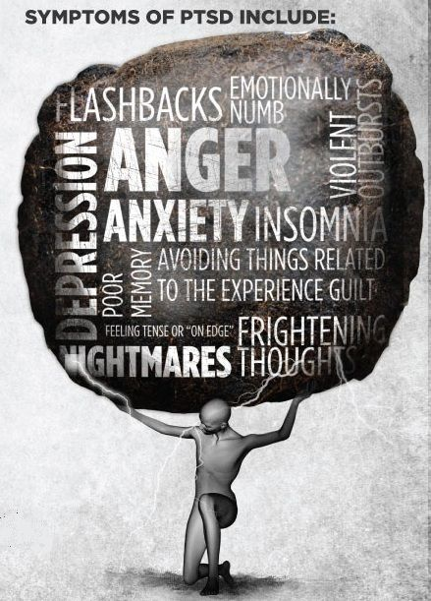



Slide 9
◦Description of the essential results and conclusions.
For the results of the Columbus Universities CTI case management Program they had a “total of 484 clients were recruited into the project: 278 into phase 1 and 206 into phase 2. (Two project sites failed to implement the program because of difficulties in hiring and retaining case managers coupled with an inability to recruit clients who met inclusion criteria). Overall follow-up rates across all time periods in phase 1 averaged 56% (625 of 1,112 possible interviews) and in phase 2 averaged 56% (459 of 824 possible interviews). There was no significant phase difference in the percentage of follow-up interviews completed.” (Kasprow, W., & Rosenheck, R. (2007, July 1)). Although, this did not work out for this CTI case management does not mean others haven’t had success. This shows that veterans do need help and do suffer from mental illnesses, which do lead to being homeless and if we can help stop that through trial and error and keep pushing through and trying to find the answer this one day will give us the greatest lead of all to help these individuals.

Slide 10
Description of why this is valuable information related to case management
This is huge information related to case management, because it shows that mental illness can lead to homelessness and veterans especially need help with their illness and find stabilization in their life. Although, no case manager is perfect or has all of the answers. This is a real everyday battle that many veterans suffer through alone and, well I do not feel anyone should have to go through that alone.

Slide 11
Resource
Kasprow, W., & Rosenheck, R. (2007, July 1). Outcomes of Critical Time Intervention Case Management of Homeless Veterans After Psychiatric Hospitalization. Retrieved April 2, 2015, from http://ps.psychiatryonline.org/doi/full/10.1176/ps.2007.58.7.929

