Slide 1

Service Dogs for those with P.T.S.D.
Presented by: Heather Micue

Slide 2
PTSD is a type of anxiety disorder that occurs “post-trauma” or after being exposed to some kind of traumatic event.
What is P.T.S.D.?

Slide 3
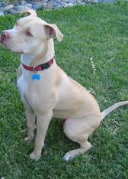
Would this service dog be right for you?

Slide 4
In 2010, the Department of Justice released a revised set of regulations for service dogs with respect to title II (state and local government services) and title III (public accommodations
and commercial facilities) of the ADA. These regulations address the rights of service dog handlers in almost all public spaces.

Slide 5
Service Dog information
Service dogs are dogs that have been individually trained to perform a specific task for individuals who have disabilities. The disabilities can vary greatly, and so do the tasks that the service dogs perform. Service dogs can aid in navigation for people who are hearing- and visually impaired, assist an individual who is having a seizure, calm an individual who suffers from Post-Traumatic
Stress Disorder, and even dial 911 in the event of an emergency. Many disabled individuals depend on them every day to help them live their everyday lives.

Slide 6
Which Registration is right for my dog?
Service Dog
Emotional and Support Dog
Mobility issues, visual impairment (blindness), hearing impairment (deafness), seizures, diabetes, PTSD, autism, epilepsy, multiple sclerosis (MS), and other physical/mental disabilities
Depression, anxiety, panic attacks, mood disorders, bipolar disorder, PTSD (post traumatic stress disorder), and other emotional/psychological conditions.

Slide 7
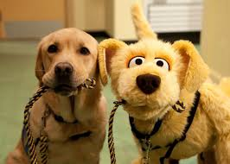
The dog then needs training

Slide 8
Can I take my service dog anywhere?
What if someone has a fear or allergy of dogs, will my service dog be allowed?
What do I do if I am refused entry or questioned by a business?
Can I be asked to leave if my service dog is being disruptive?
Are businesses allowed to question me or refuse to give me service?
Does my service dog have to be on a leash?

Slide 9
So for most of the questions that are asked…the service dogs are able to go anywhere with their “person”

Slide 10
The end …woof!!!!!

