Slide 1


Cultural Diversity
In
Mental Health
Kerry Veara

Slide 2
Introduction
What is cultural diversity in mental health?
As the professional health care provider we will need to be culturally aware of the beliefs about the causes of mental illness, the influence of their culture that they have, and knowing the issues to consider during a cross-culture clinical consultation. It is having cultural awareness that is needed to give the patient that feeling of trust and understanding to hopefully have a successful treatment.

Slide 3
Information about the Article:
Title: Understanding Cultural Diversity in Mental Health
Authors: Seah E, Tilbury F, Wright B, Rooney R.
Journal Name: Multicultural Mental Health Australia
Date of Publication: 2002

Slide 4

This article coincides with lesson 3 in the case management course. The article is about the cultural diversity that is huge part of mental health.
Lesson 3 is about ethics in case management and the patients rights, which include their cultural background and treating their diversities with the respect and dignity that they deserve.

Slide 5
The Influence of Culture
What is culture?
Culture influences all people’s norms, values and behaviors
Culture influences how we understand, interpret and respond
Because of culture, all people are inclined to be ethnocentric
Despite strength of cultural influences, cultures vary individually

Slide 6

Diversity is:
      Cultural competence
        Cultural diversity
          Transcultural health care
            Cross-cultural health care
              Model of cultural competence

Slide 7

Racial and ethnic differences
    Multicultural health care
      Culture
        Culturally and linguistically appropriate services

Slide 8
Cultural Awareness
The self-examination and in-depth exploration of one’s own cultural background
To recognize one’s own biases, prejudices, and assumptions about individuals who are different
“Do my actions support stigma, isolation, and devaluation of people with disabilities? Am I sensitive to cultural differences in response to and support of this population?”

Slide 9
CALD
Culturally and Linguistically
Diverse Backgrounds
Health care providers are encouraged to have:
Culturally-appropriate
OR
Culturally-sensitive
To the assessment, diagnosis and management of the clients

Slide 10
Cultural Competence
Have I “ASKED” myself the Right questions?
A wareness: Am I aware of my personal biases towards other cultural groups?
S kill: Do I have the skill to conduct a cultural assessment?
K knowledge: Do I have knowledge of the patients world view?
E ncounters: How many diverse patients have I had in the past?
D esire: What is my genuine desire to want to be culturally competent?

Slide 11
Ethnocentrism
Ethnocentrism occurs when one culture is judged by standards of one’s own culture. When an individual is living in a different cultural context, one of these four processes could take place:
Integration: maintaining own values and beliefs, as well as those of the large social group to an extent
Assimilation: non-dominant group does not maintain identity and seeks daily interaction with other cultures
Separation: maintaining own culture and avoiding interaction with other cultures
Marginalization : contact with own culture while others are avoided

Slide 12
Mental Health and Mental Illness Among Culturally Diverse Communities
There are a number of factors to consider which may be crucial to the mental health of individuals or communities. They include:
Pre-migration
  The process of resettlement
    Response to the stressors of the dominant culture

Slide 13

Beliefs About the Causes of Mental Illness
Biological factors
  Psychological factors
    Social/Migration factors: before arrival
      Transit factors
        Cultural and religious factors
          Social/Migration factors: after arrival

Slide 14
Using Professional Interpreters
It is essential to use a professional interpreter:
Do not use family, friends or non-professional interpreters. If you do, you could be legally liable
Face to face interpreting or telephone interpreting may be appropriate to use in mental health care with CALD clients

Slide 15
Cultural Assessment
Important points to consider when assessing people from different cultures:
When the client was born and how long have they been in this country
What the client’s ethnic background is
Who the client’s major support people are

Slide 16
What the client’s primary and secondary languages are and their capabilities in reading and writing
What their non-verbal communication style is like
What the client’s religious background is, and its importance in daily life
Whether the client’s income is adequate to meet the needs of the client and their family

Slide 17
Issues to Consider During a Cross-Cultural Clinical Consultation
May use traditional or folk healing methods concurrently with western medical treatments
Family may be very important, they may be included in the consultation about the condition and treatment

Slide 18
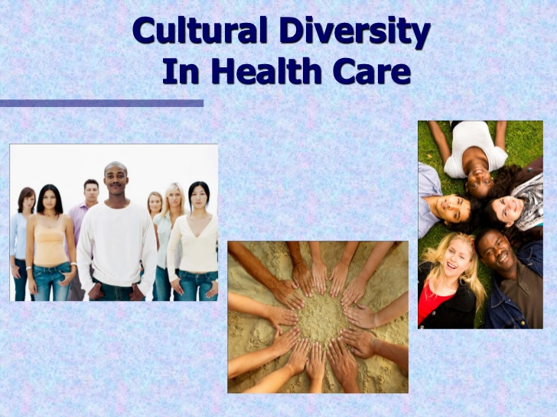
Some cultures use terms like “nerves,” “wind,” “cold,” or “hot” to explain or describe symptoms
Respect for the client’s cultural background and for their explanatory model of the presenting problem constitutes a key element of the interaction and successful engagement of the treatment process

Slide 19
Communicating Effectively
Interpersonal communication involves both verbal and non-verbal interaction. The following are some communication tips on communicating across cultures:
  Explain your role to the patient
    Understand rules of communication
      Be aware that people express emotions in many ways
        Do not assume English proficiency

Slide 20
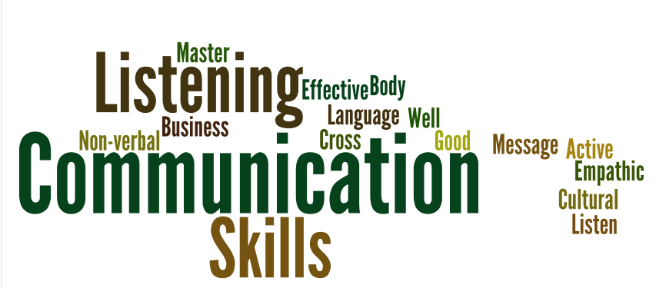
Note different meanings of words
  Do not make assumptions about a patient’s level of understanding
    Respect beliefs and attitudes
      Take the time to explore any issues
        Speak clearly and slowly
          Listen and observe

Slide 21
Using The Cultural Awareness Tool
This has been designed for helping you in understanding the patient’s perception of their problem:
The Cultural Assessment Tool involves asking the patient the following questions:
What do you think caused your problem (use patient’s words)?
Why do you think it started when it did?
What do you think your “illness” does to you? What are the chief problems it has caused for you?

Slide 22
4. How severe is your (illness)? What do you fear most about it?
What kind of treatment/help do you think you should receive?
Within your own culture, how would your (illness) be treated?
How is your community helping with your (illness)?
What have you been doing so far for your (illness)?
What are the most important results you hope to get from treatment?
Questions should be asked gently, leaving the client plenty of time to consider their replies and to expand on them. It is important that sensitivity is applied

Slide 23
Cultural Competence in
Mental Health Care
It takes time and practice to feel competent in mental health care, especially with cultural diversity.
A practitioner is culturally competent when they:
Can understand the concept of culture, and how it can influence people, including emotions generated by intercultural interactions
Acceptance of diversity
Equity and access

Slide 24
Why is this valuable information needed for a case manager?
Mental health case managers coordinate a variety of community services, monitoring the services, and advocating for individuals suffering from ongoing mental health issues. Case Managers also can provide support for the families and friends of these people. Cultural diversity in this field is a crucial part of treatment. If the case managers are not aware of the cultural differences, there will be no trust or respect from an individual seeking help, which will make a successful treatment impossible and will set that individual up for failure.

Slide 25

Resources
There are many resources available that address the issue of cultural competency and the provision of culturally competent care.
http://erc.msh.org/quality&culture
www.crosshealth.com
www.xculture.org

Slide 26
www.amsa.org/div
www.omhrc.gov/clas
http://healthlinks.Washington.edu/clinical/ethomed
United States Department of Health and Human Services

